Slide 1
Using DeepMind’s StarCraft 2 API
By: Jeffrey Cain

Slide 2
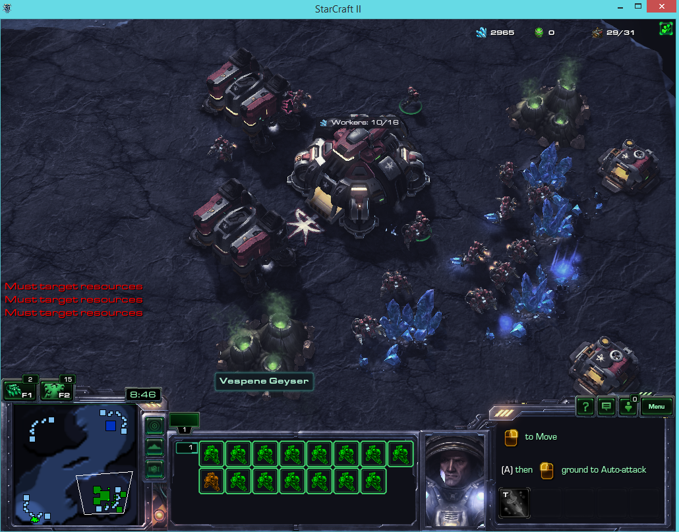
What is DeepMind and PySC2?
Blizzard and Deep Mind Partnership
Python
Machine Learning API for the StarCraft 2 Environment

Slide 3
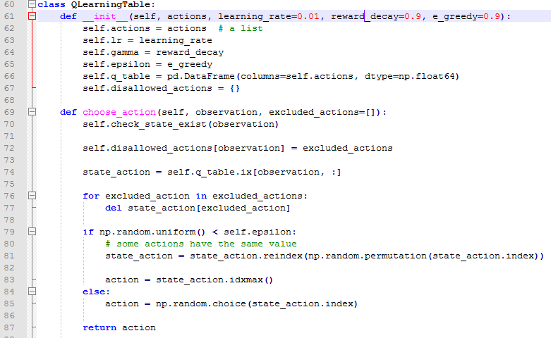
Q-Learning
Reinforcement Learning
Initialize Q-Table
Choose an action
Perform action
Measure Reward
Update Q Table

Slide 4
Rewards
Teaching an Agent what and what not to do
Creating a simple scoring system
Rewarding the agent for killing units, 0.2, and buildings, 0.5,
Winning:1, Draw:0 and Losing:-1 affects these rewards

Slide 5
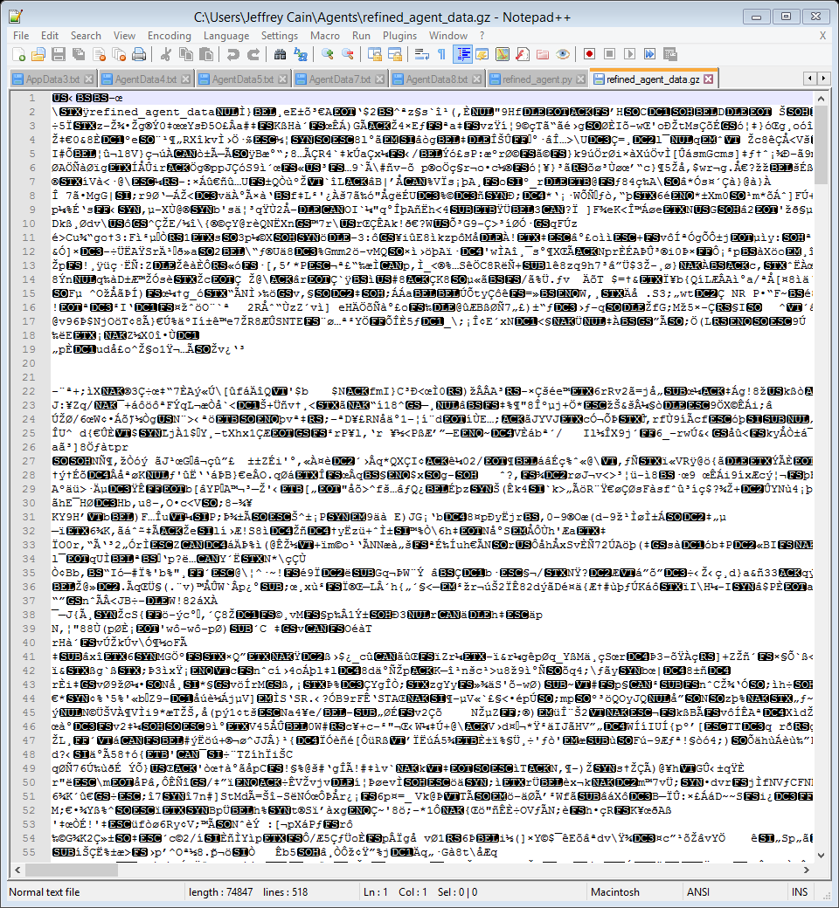
Storing Learning Table
Q-Tabke keeps track of all states and actions
Storing the Q-Learning Table
Used to continue learning
Save and relaunch program without re-learning

Slide 6
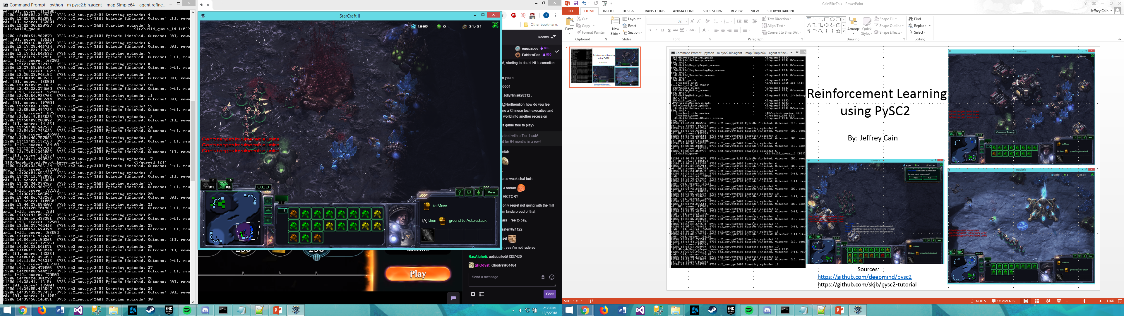
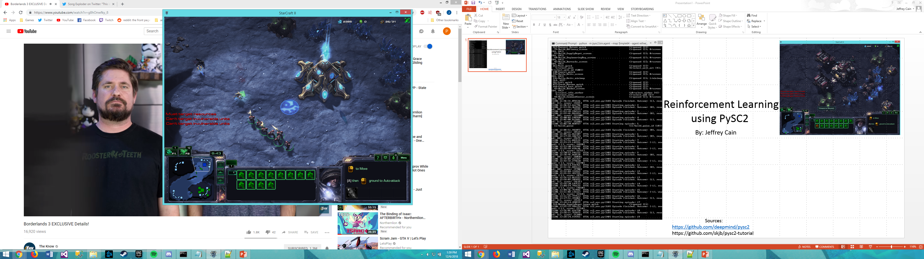
How the AI Runs

Slide 7
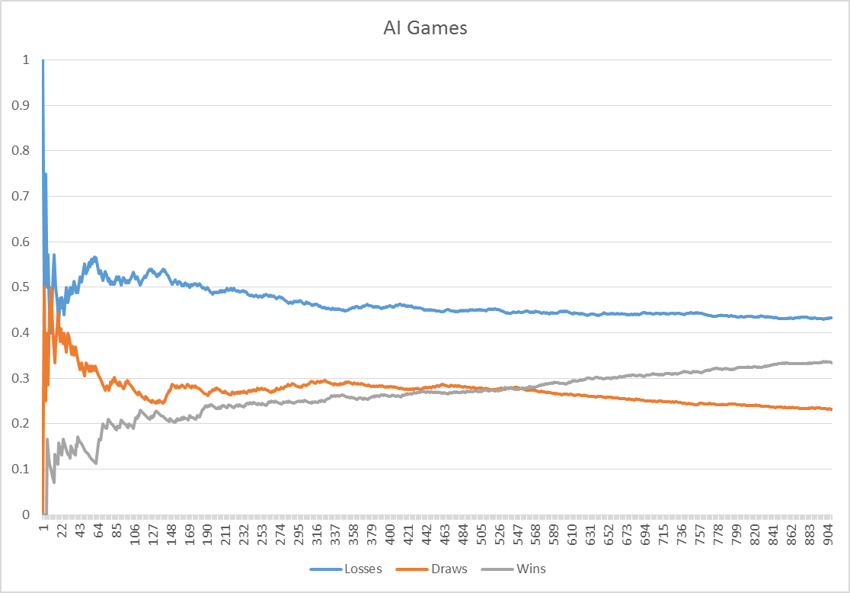
Results

Slide 8
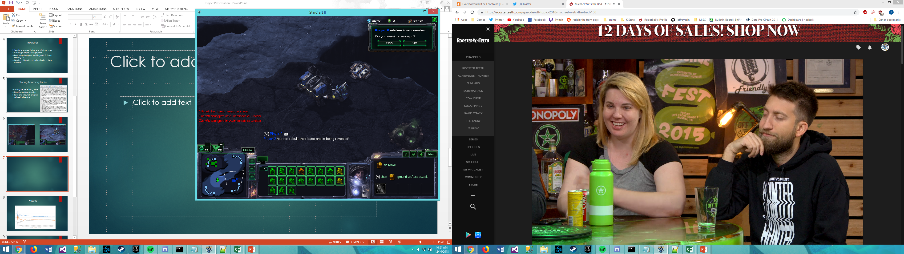
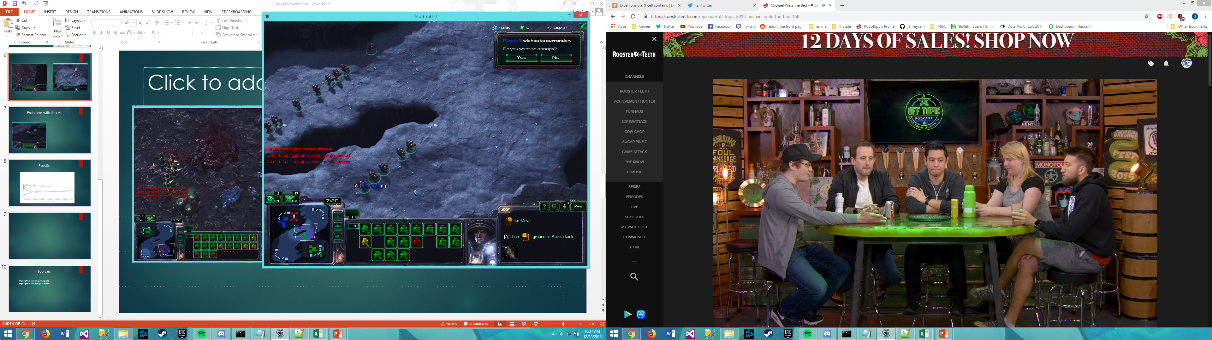
Problems with the AI

Slide 9
Future Work
Build more buildings
Train more units
Learn different StarCraft Races

Slide 10
Sources
https://github.com/deepmind/pysc2
https://github.com/skjb/pysc2-tutorial

